Slide 1

Nilavembu Herbs Proof Of Concept(POC) in Microsoft Azure
By Andy McLaughlin

Slide 2
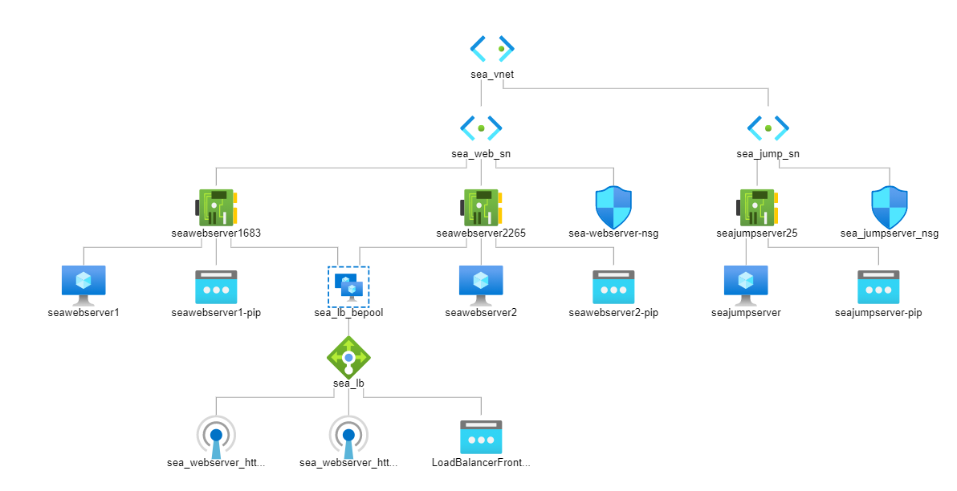
SEA_VNET NETWORK DIAGRAM

Slide 3
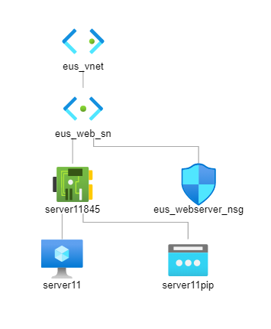
EUS_VNET NETWORK DIAGRAM

Slide 4
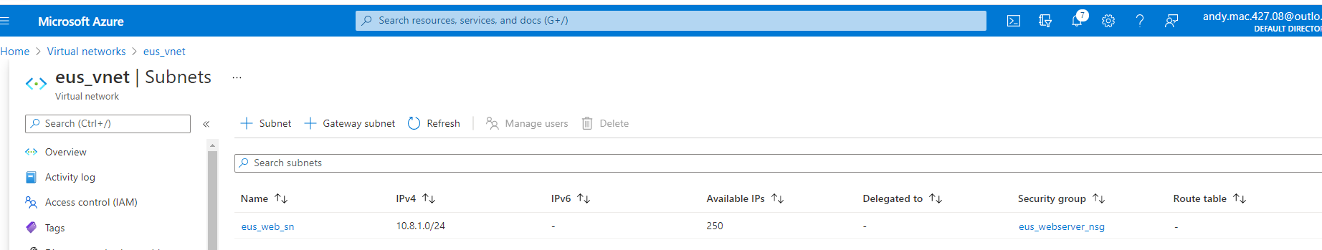
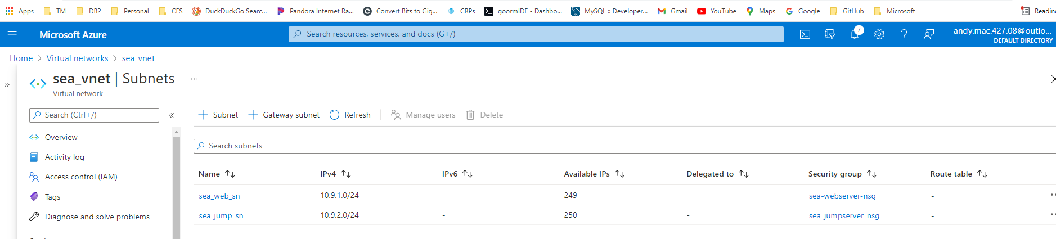
Create Resource Group: eus_rg
Create Resource Group: sea_rg
Create Vnet: eus_vnt (10.8.0.0/16)
Create Subnet: eus_web_sn (10.8.1.0/24)
Create Vnet: sea_vnt (10.9.0.0/16)
Create Subnet: sea_web_sn (10.9.1.0/24)
Create Subnet: sea_jump_sn (10.9.2.0/24)

Slide 5
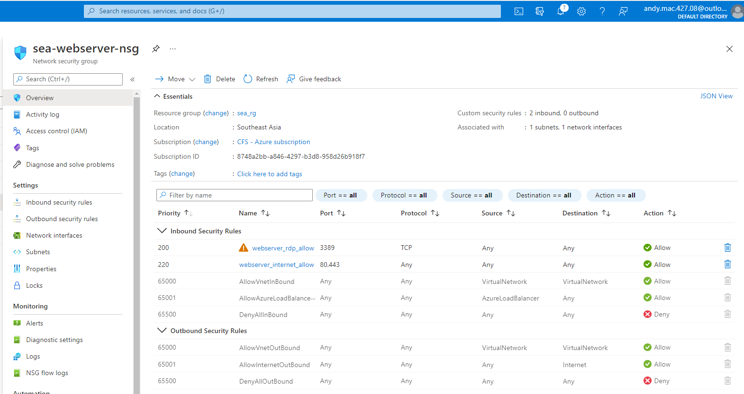
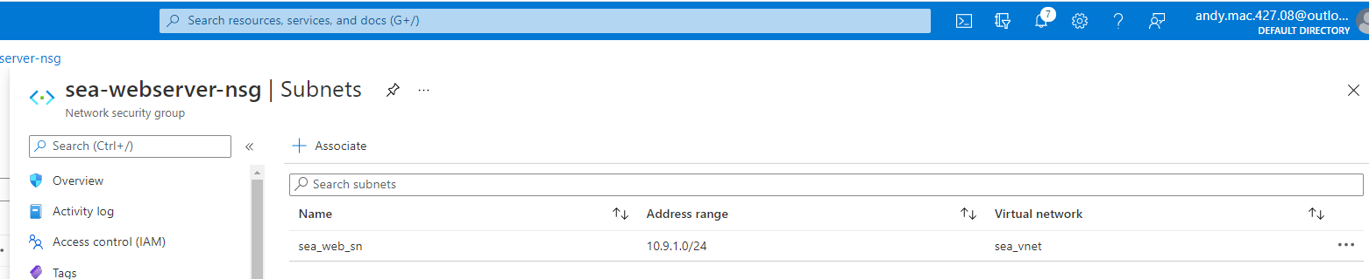
Create NSG: sea_webserver_nsg
Configure sea_webserver_nsg with webserver_rdp_allow
Configure sea_webserver_nsg with webserver_internet_allow
Associate sea_webserver_nsg with sea_web_sn

Slide 6
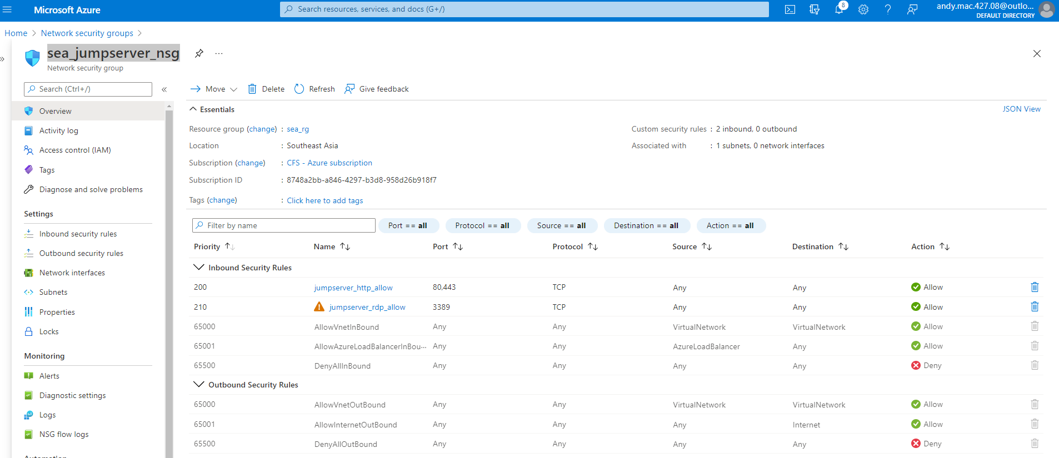
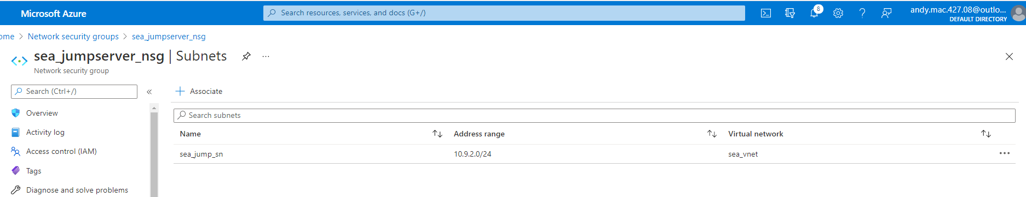
Create NSG: sea_jumpserver_nsg
Configure sea_jumpserver_nsg with jumpserver_http_allow
Configure sea_jumpserver_nsg with jumpserver_rdp_allow
Associate sea_jumpserver_nsg with sea_jump_sn

Slide 7
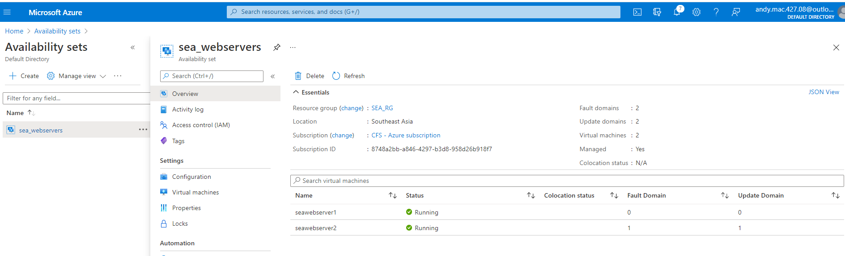
Create Availability_set: sea_webservers with seawebserver1 and seawebserver2

Slide 8
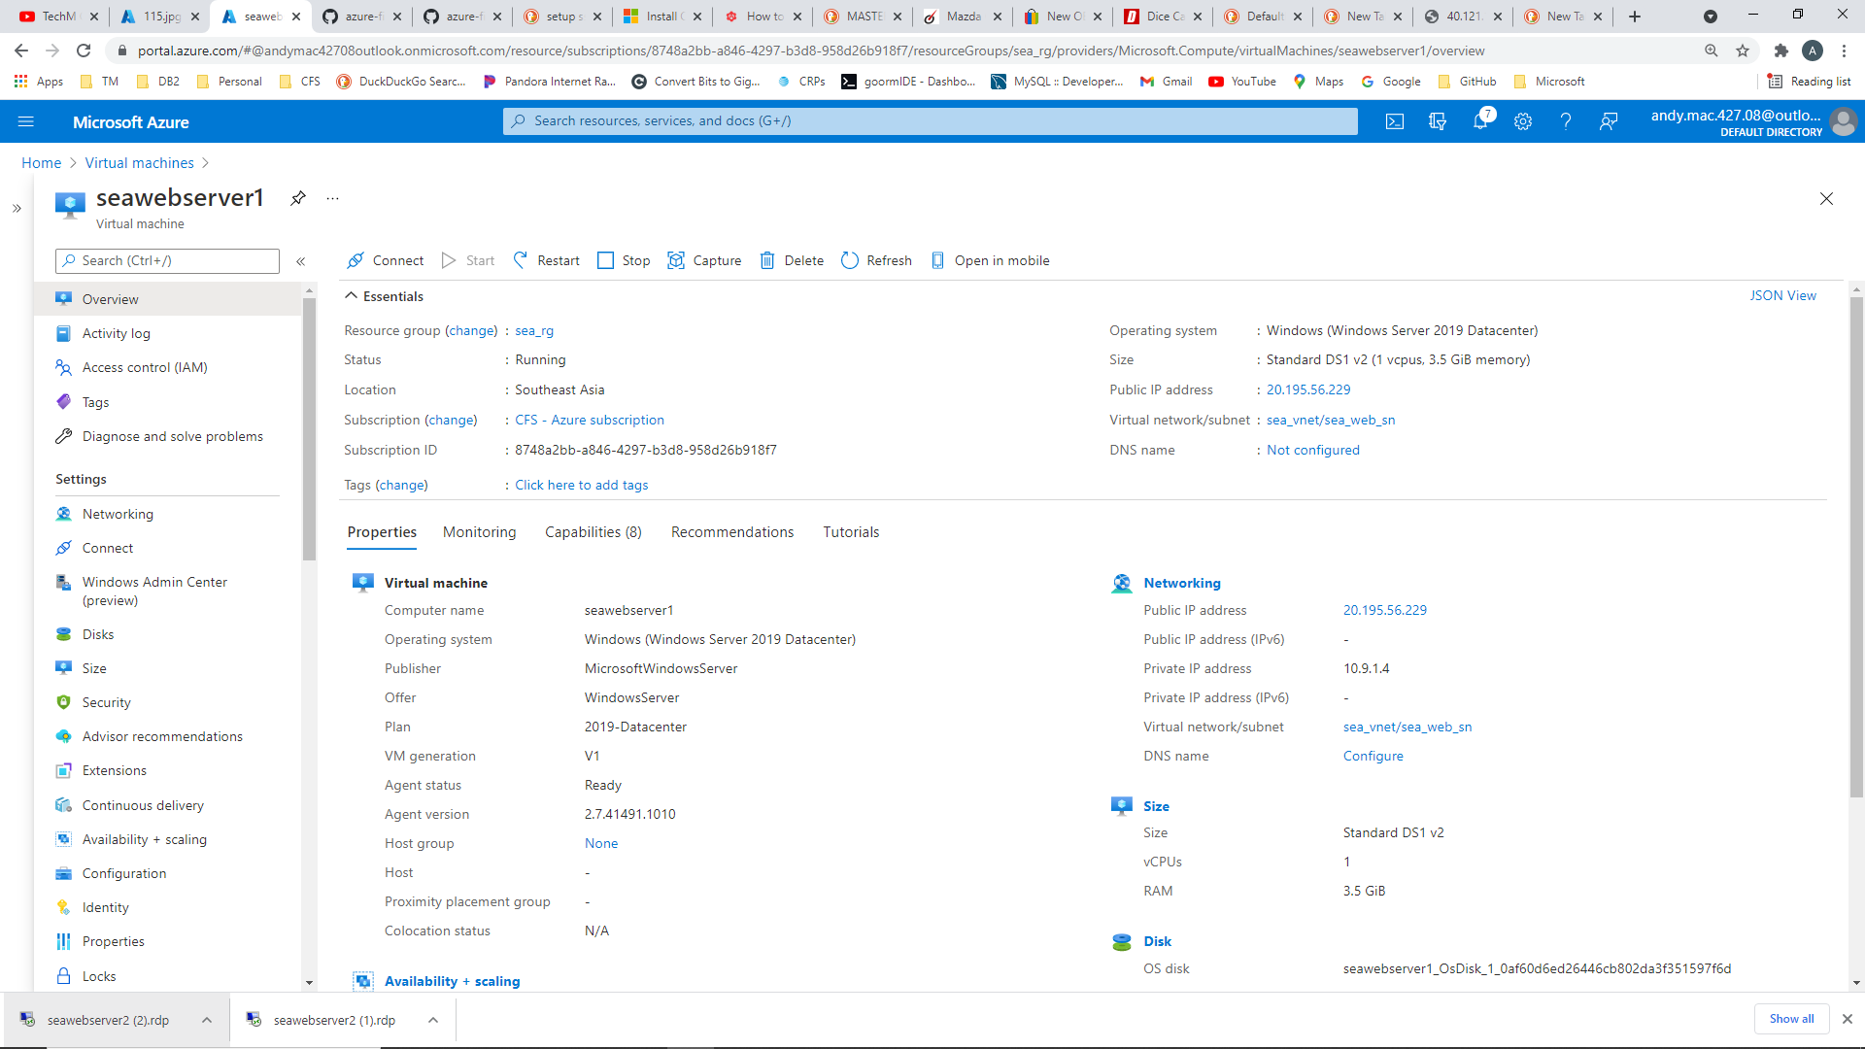
Create SEA virtual machines
Create virtual machine: seawebserver1
Public IP: seawebserver1-pip (20.43.150.185)
Private IP: 10.9.1.4
Availability Set: sea_webservers
Install webservice
Add frontend web…index.html

Slide 9
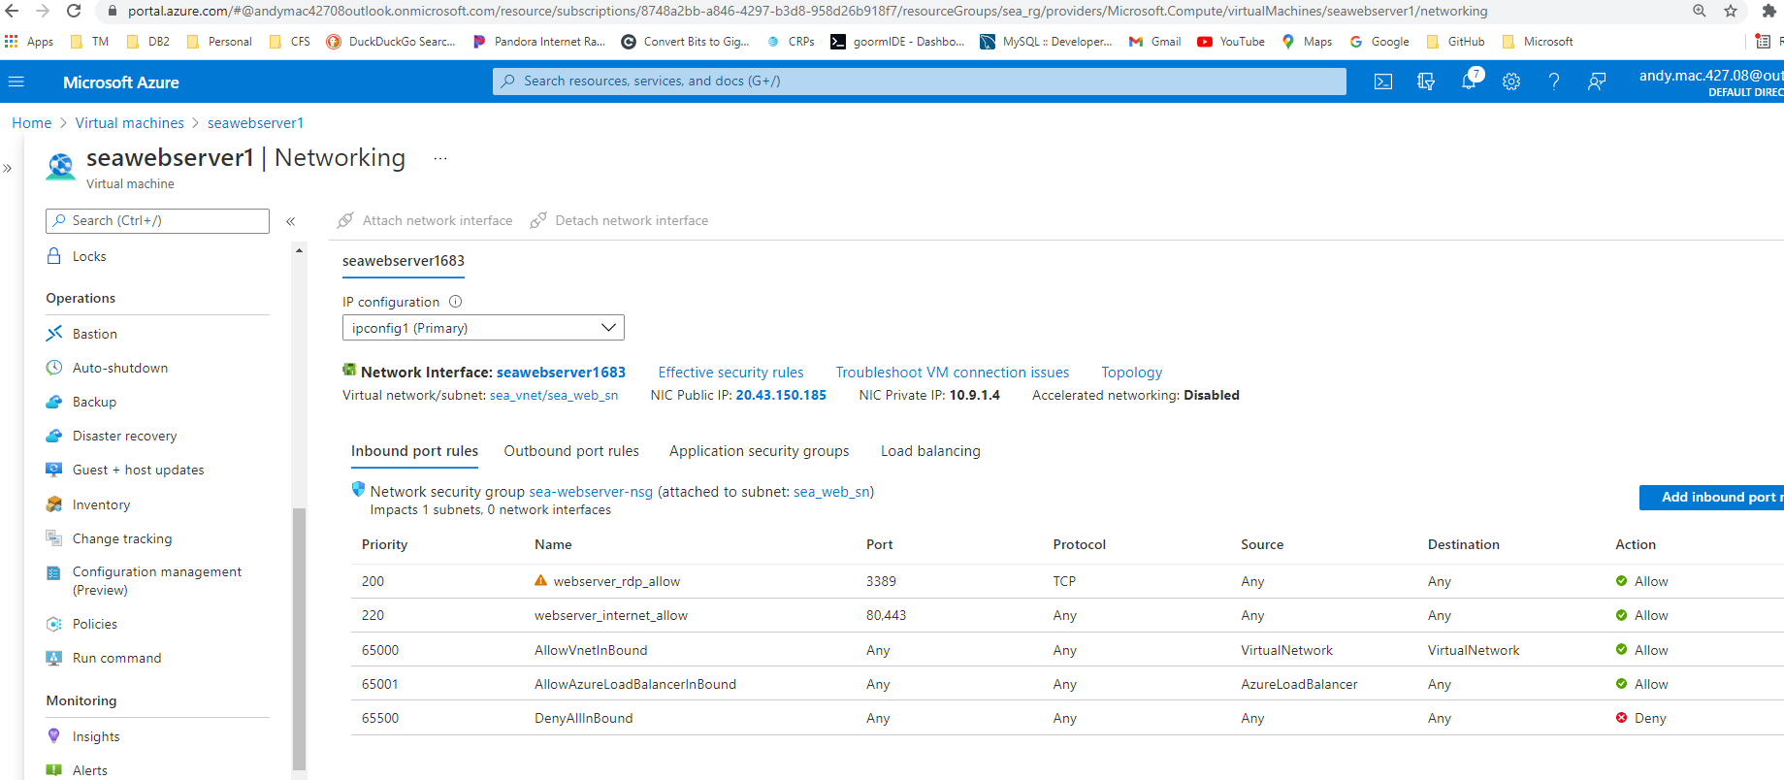

Slide 10

Create virtual machine: seawebserver2
Public IP: seawebserver1-pip (20.44.220.155)
Private IP: 10.9.1.5
Availability Set: sea_webservers
Install webservice
Add frontend web…index.html

Slide 11
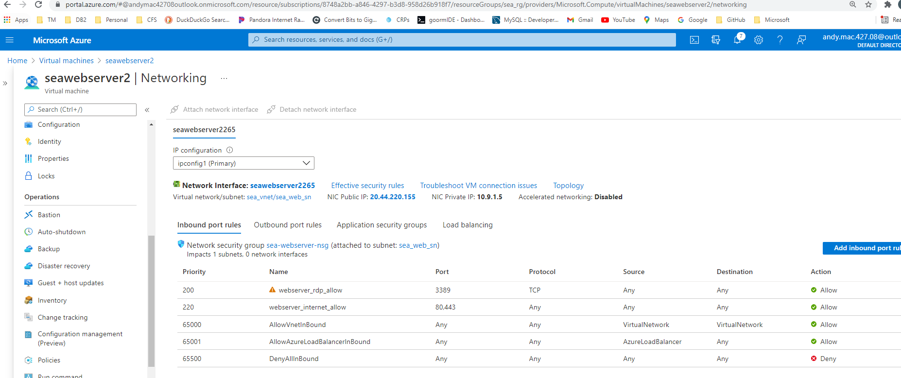

Slide 12
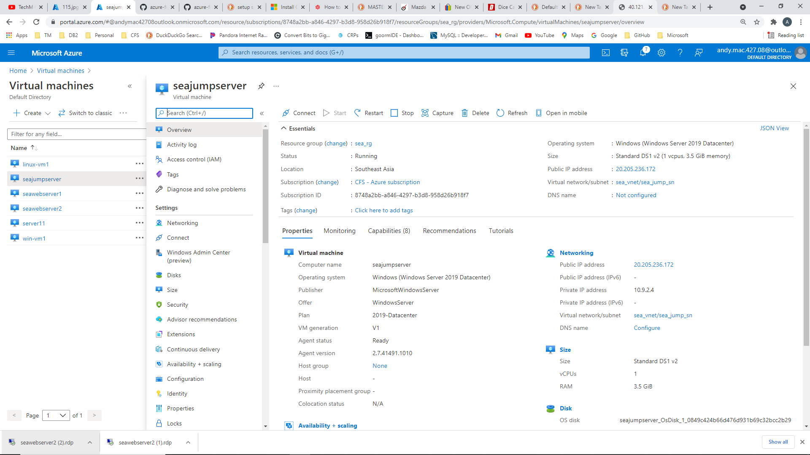
Create virtual machine: seajumpserver
Public IP: seawebserver1-pip (20.205.236.172)
Private IP: 10.9.2.4

Slide 13
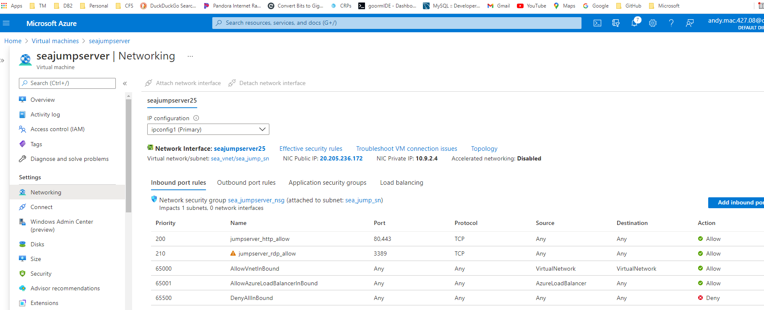

Slide 14
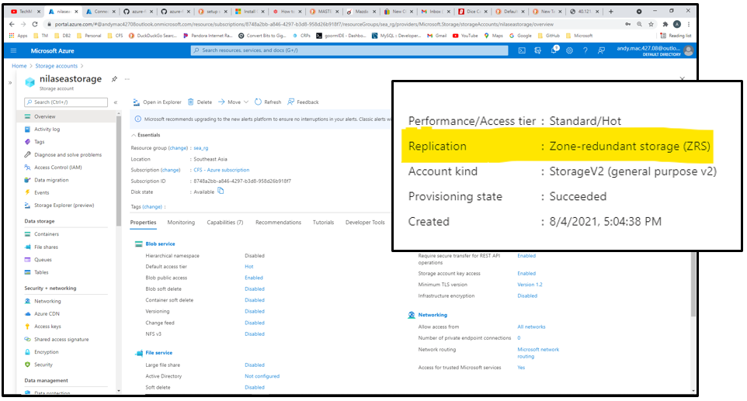
Create Storage Account: nilaseastorage with zone redundancy for high resiliency

Slide 15
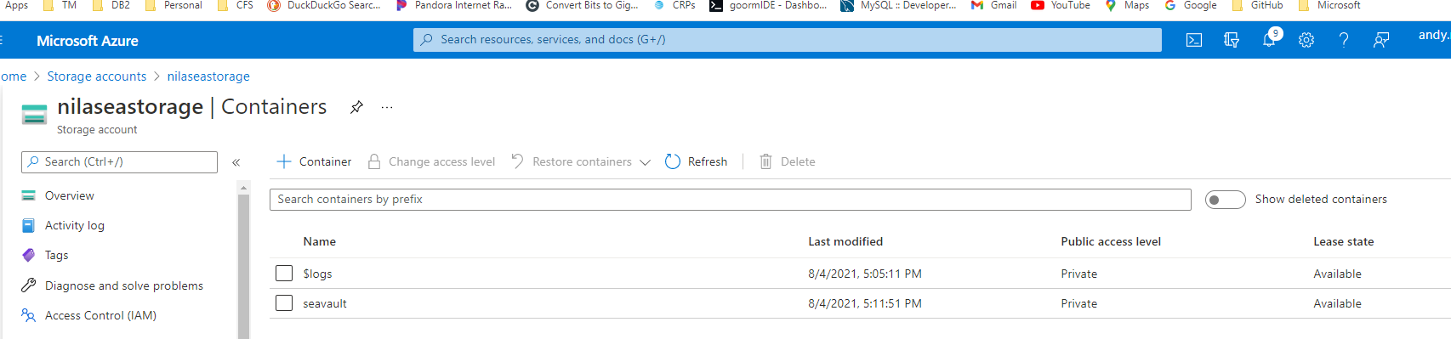
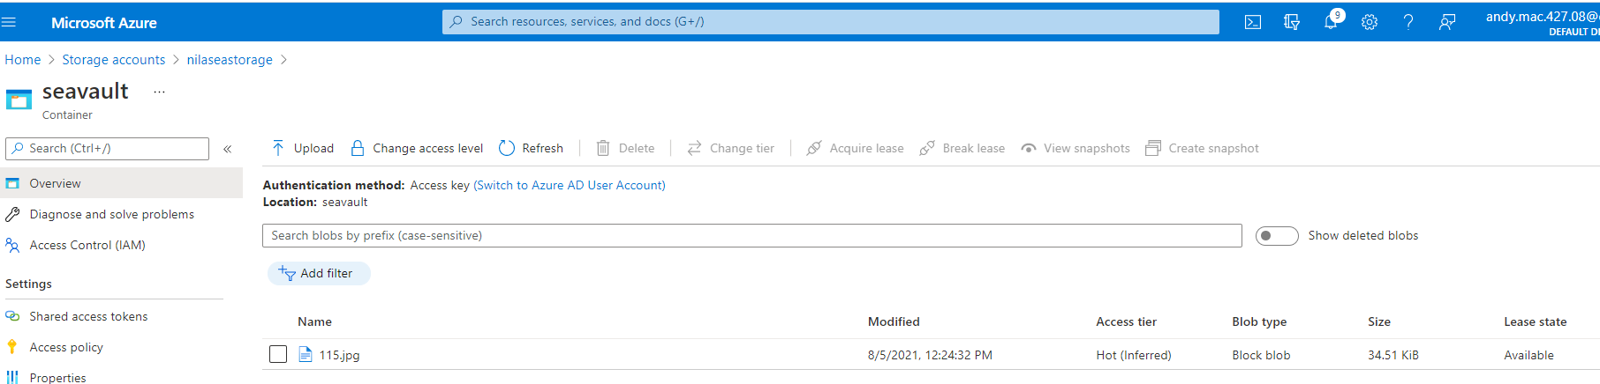
Create Container: seavault
Upload image to container

Slide 16
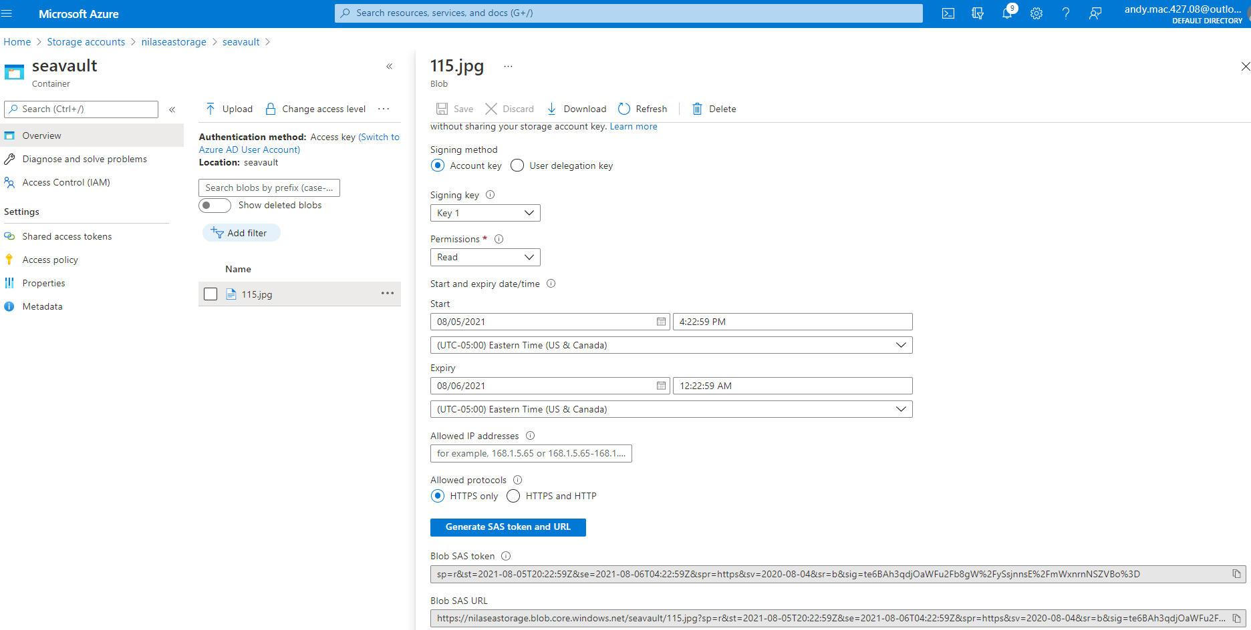
Generate SAS Token and URL and access from webserver

Slide 17
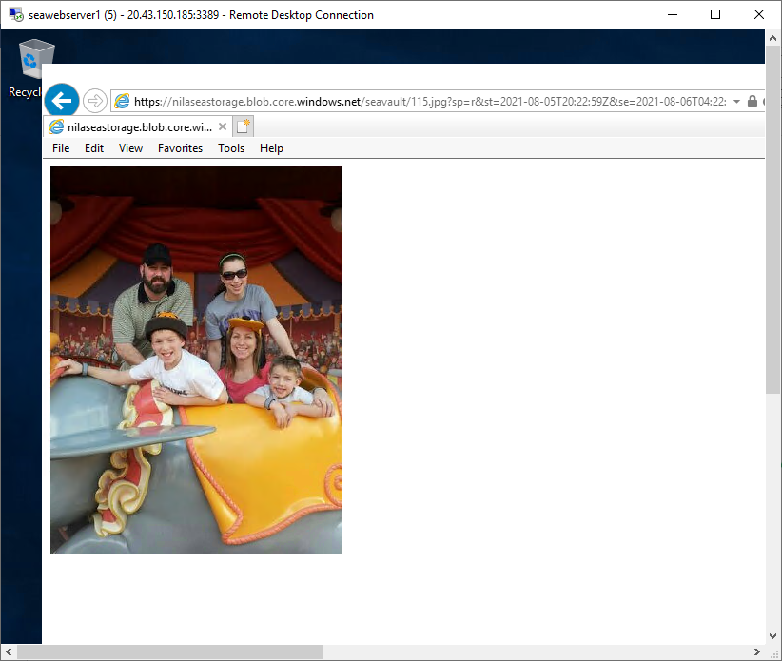
Access object from seawebserver1 webserver

Slide 18
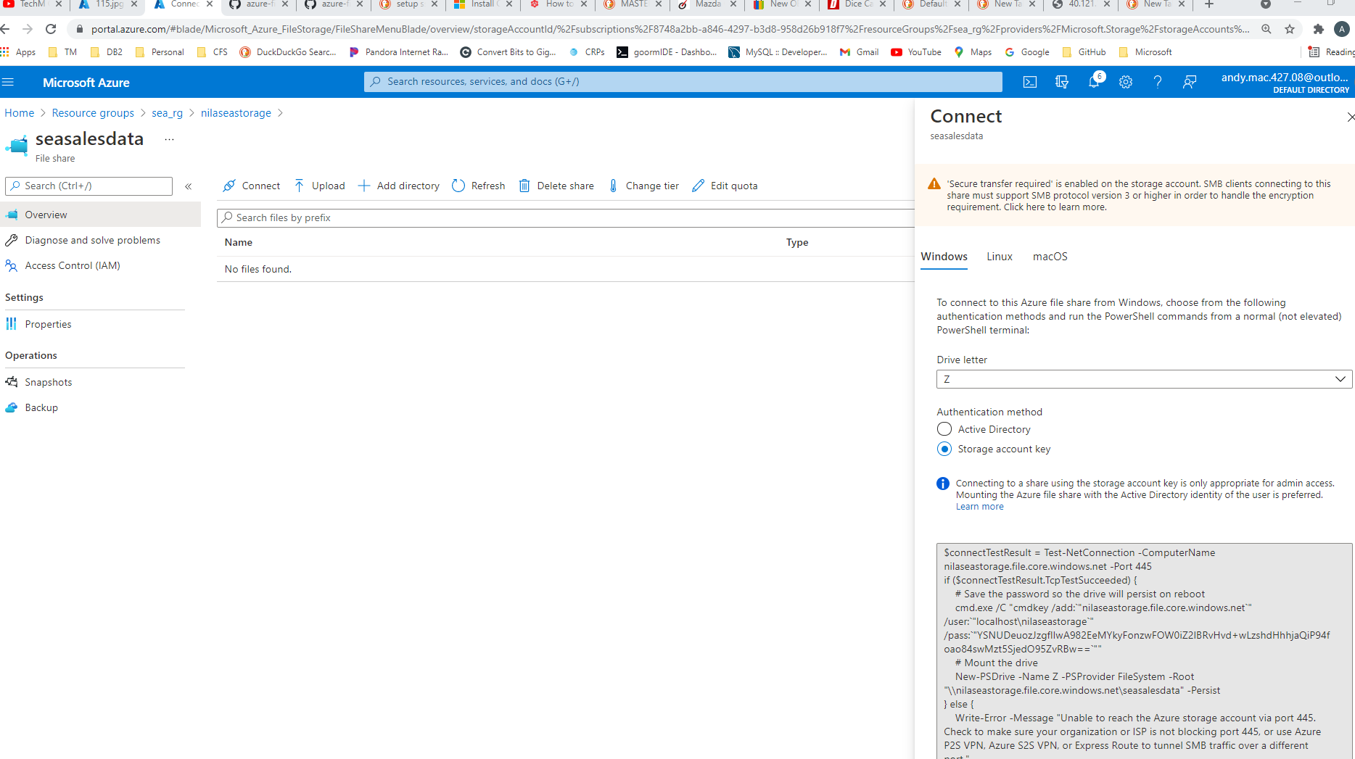
Configure File Share on storage account: seasalesdata
Generate storage account key for access

Slide 19
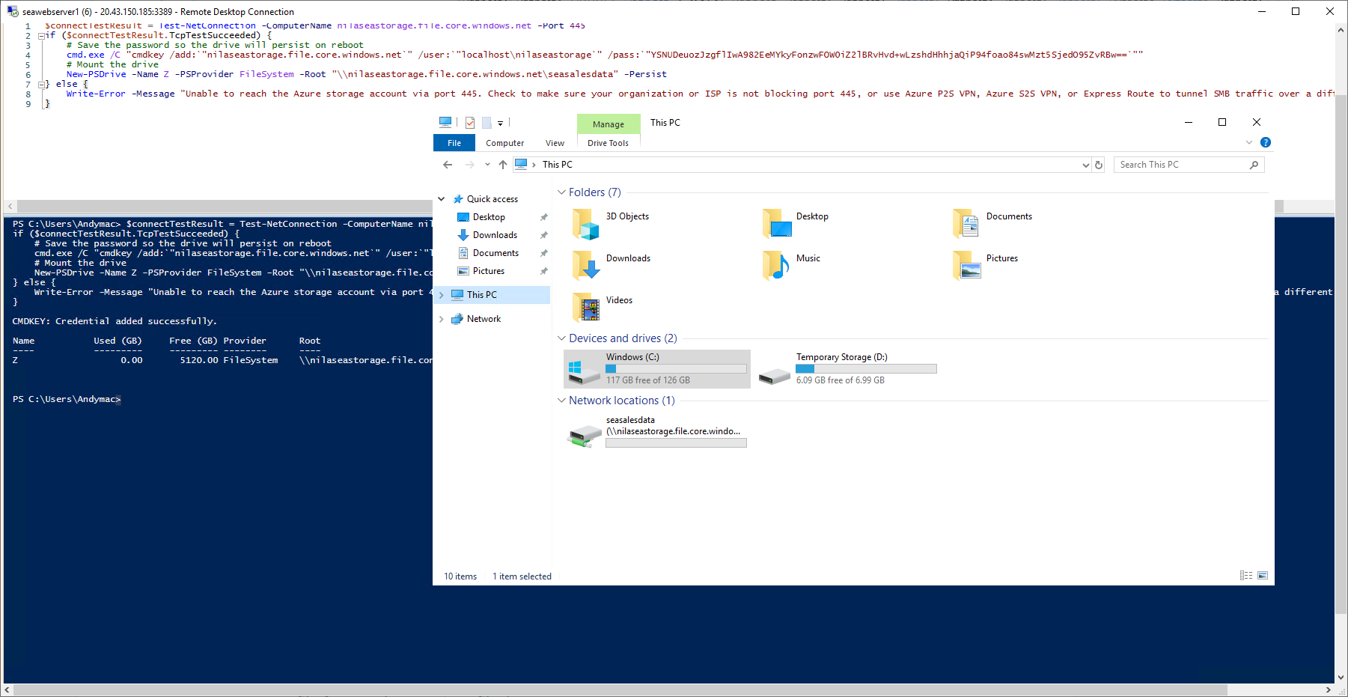
Create drive connection on seawebserver1

Slide 20
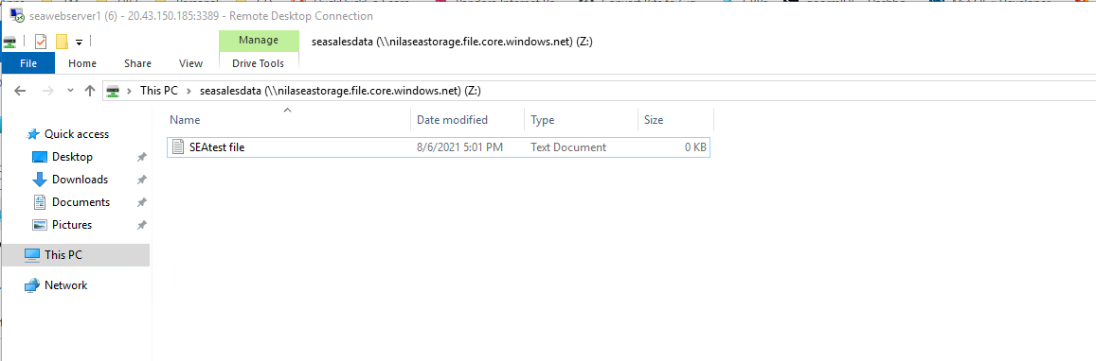
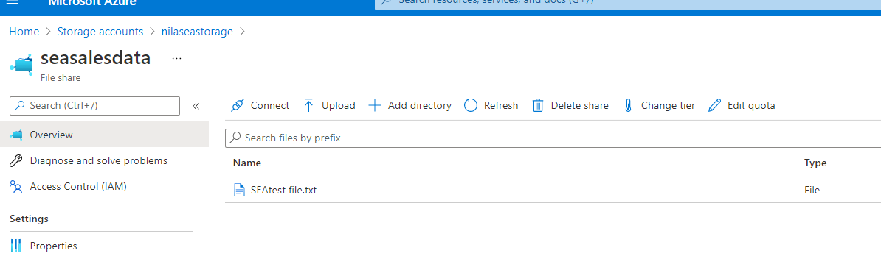
Store file from webserver into file share

Slide 21
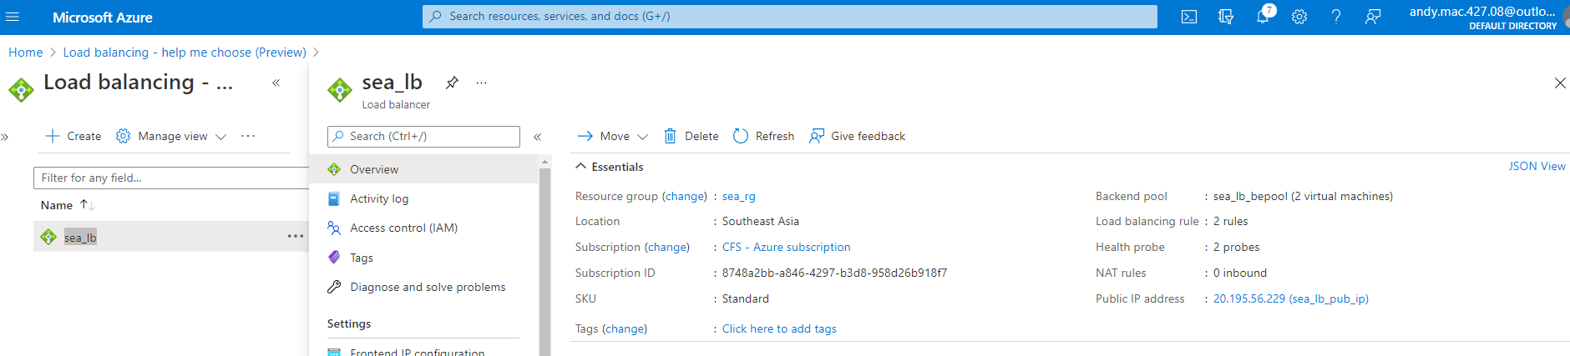
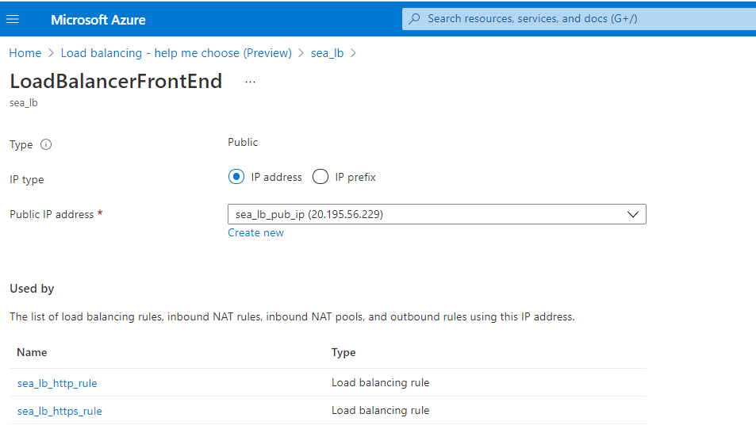
Create Load Balancer: sea_lb (20.195.56.229 (sea_lb_pub_ip))

Slide 22
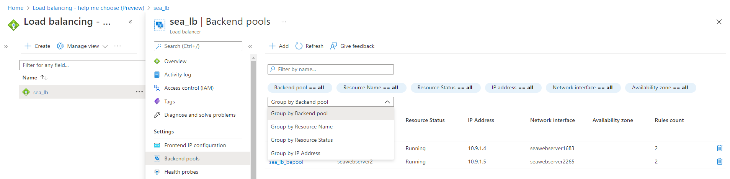
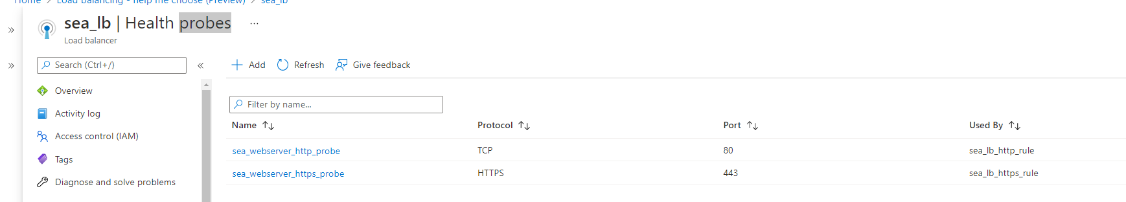
Create backendpool: sea_lb_bepool
Create Health Probes: sea_webserver_http_probe (port 80)
sea_webserver_https_probe (port 443)

Slide 23
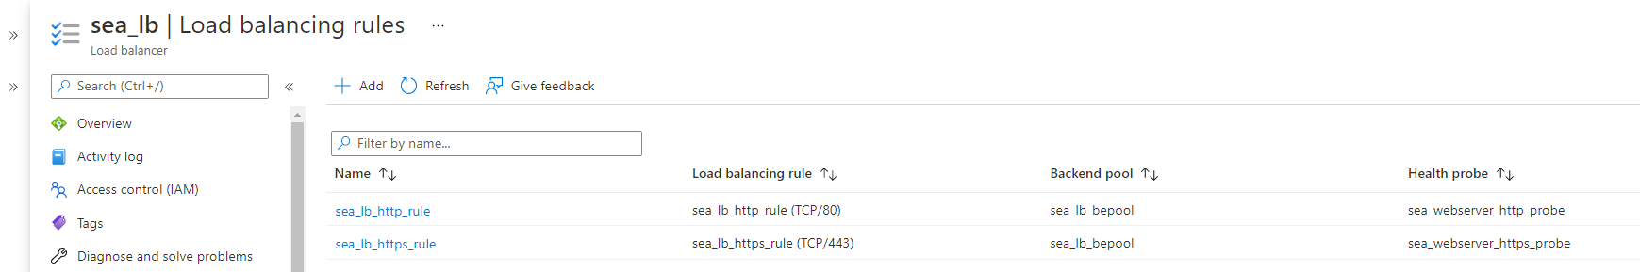
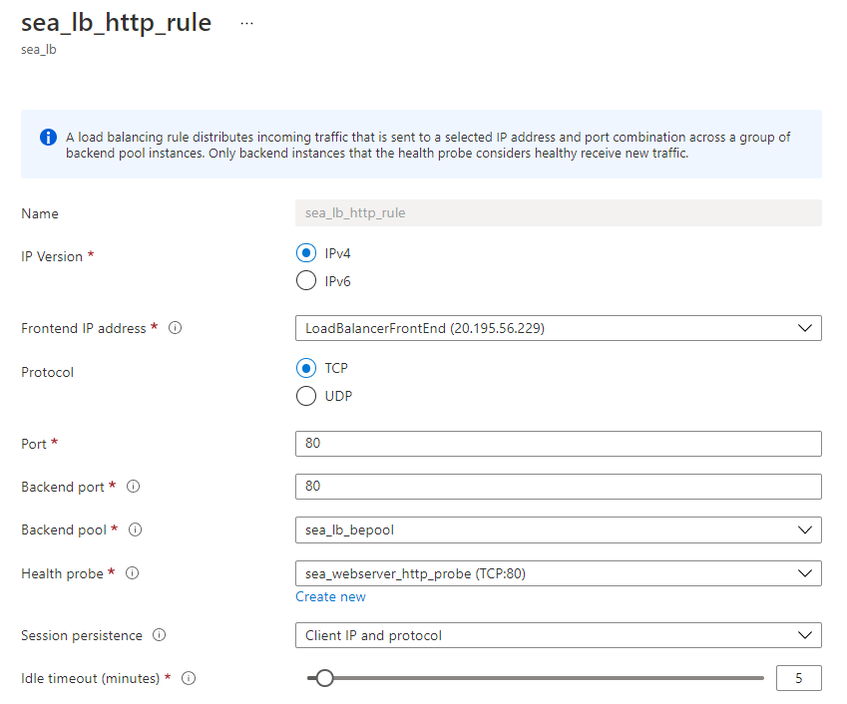
Create lb rules: sea_lb_http_rule (backend port: 50000)
sea_lb_https_rule (backend port: 50001)
with client affinity

Slide 24
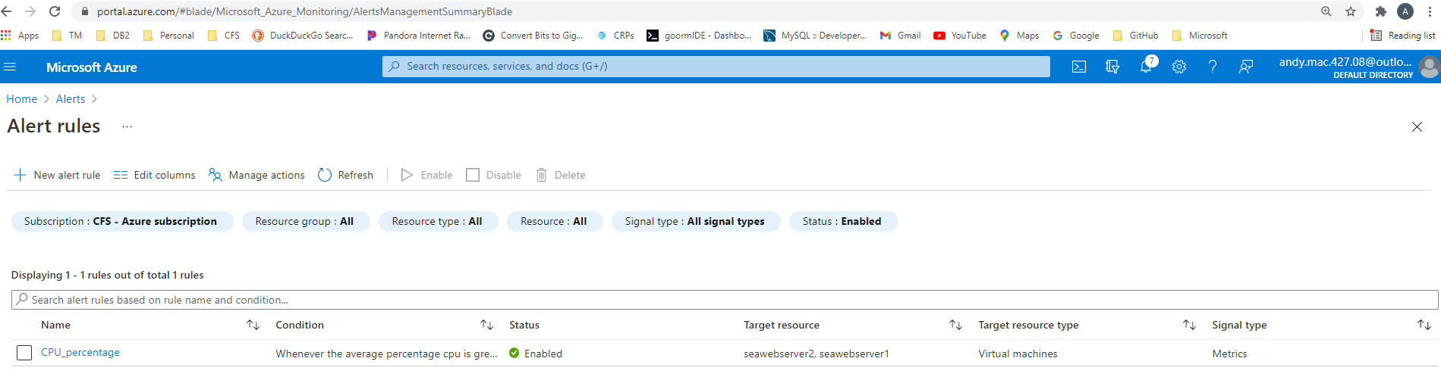
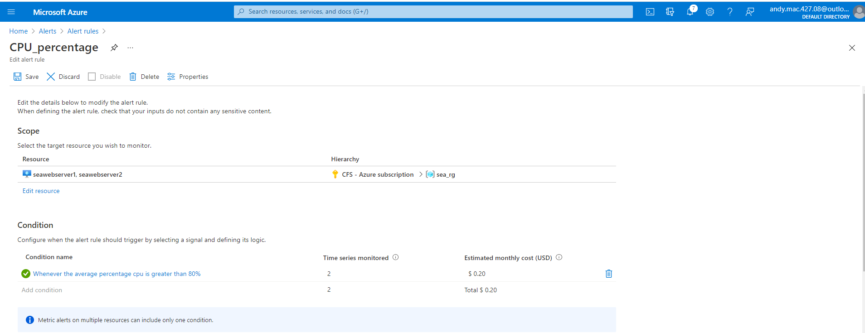
Implement CPU Alert: CPU_percentage

Slide 25
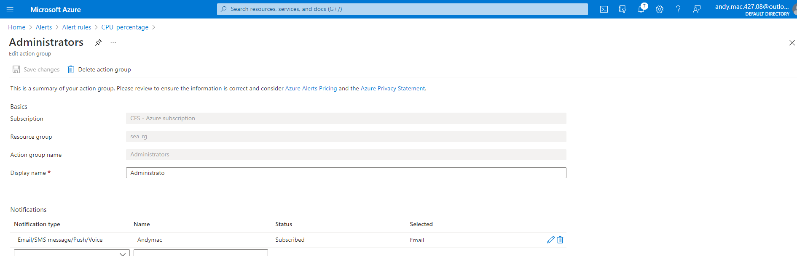
Create action group: Administrators to email when alert is activated

Slide 26
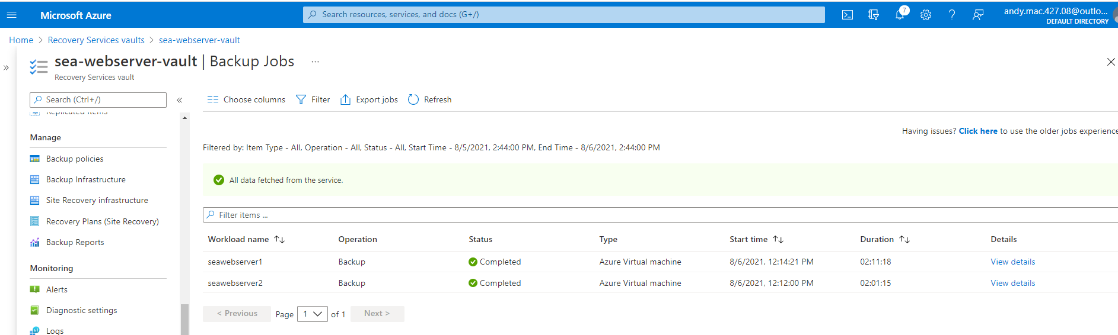
Create Recovery Service Vault: sea-webserver-vault
Configure backup policy: sea-webserver-backup

Slide 27
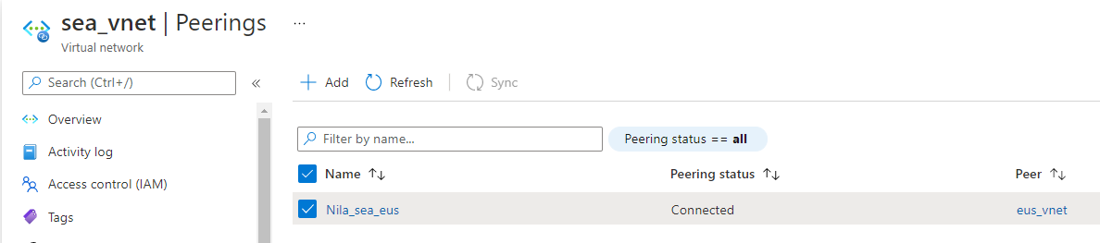
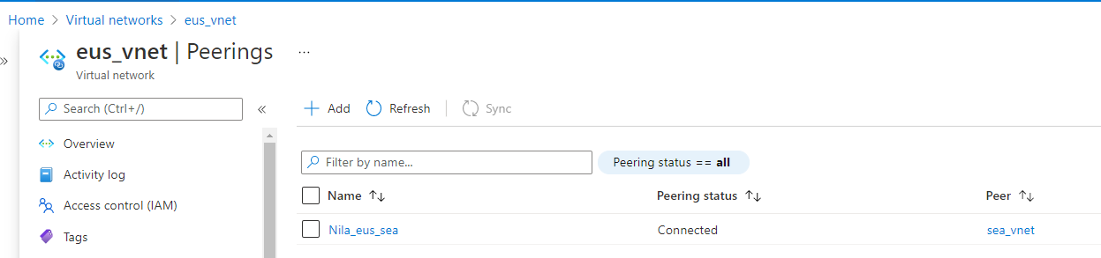
Create VNET peering:
Nila-sea-eus
From SEA_VNET to EUS_VNET:
Nila-eus-sea
From EUS_VNET to SEA_VNET

Slide 28
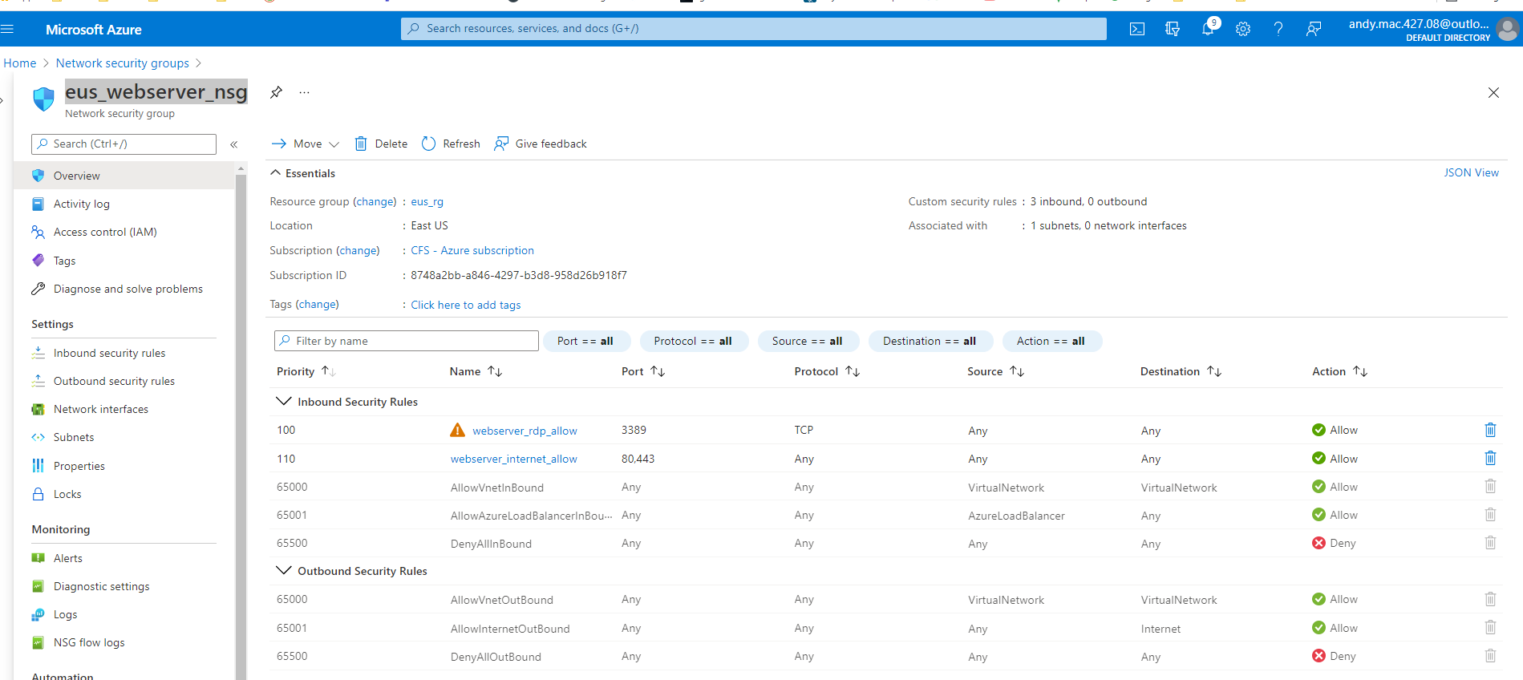
Create NSG: eus_webserver_nsg
Configure eus_webserver_nsg with webserver_rdp_allow
Configure eus_webserver_nsg with webserver_internet_allow

Slide 29
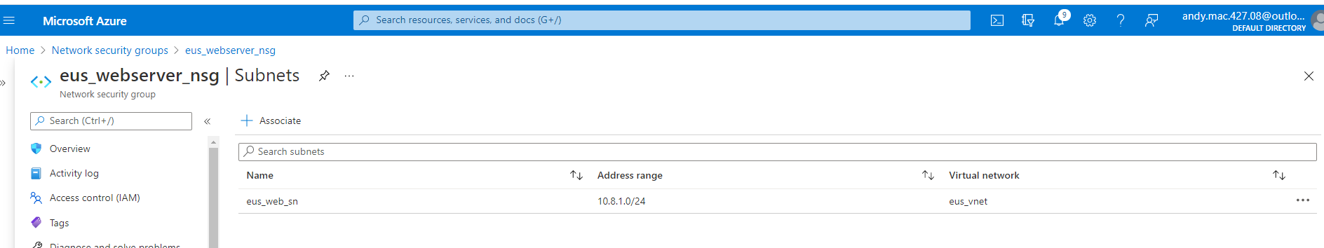
Associate eus_webserver_nsg with eus_web_sn

Slide 30
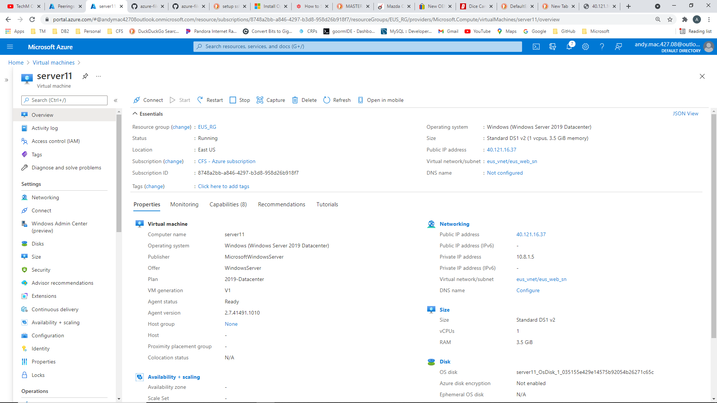
Create EUS Virtual Machine
Create virtual machine: server11 Andymac
Public IP: server11-pip (40.121.16.37)
Private IP: 10.8.1.5
Install webservice
Add frontend web…index.html

Slide 31
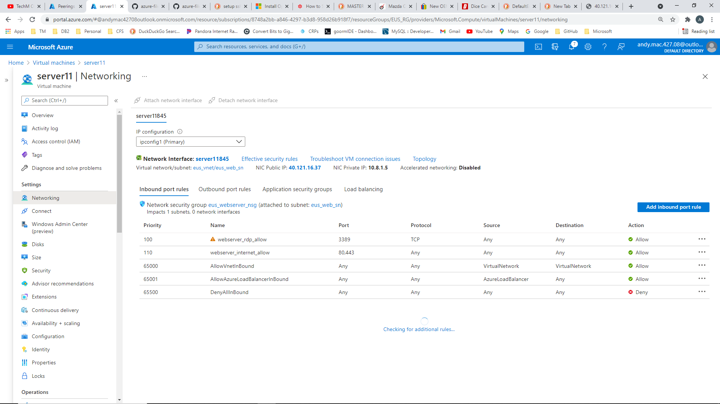

Slide 32
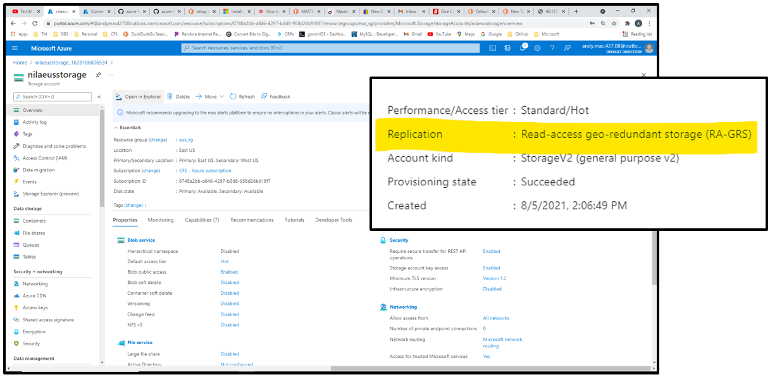
Create Storage Account: nilaeusstorage with geo-redundant storage

Slide 33
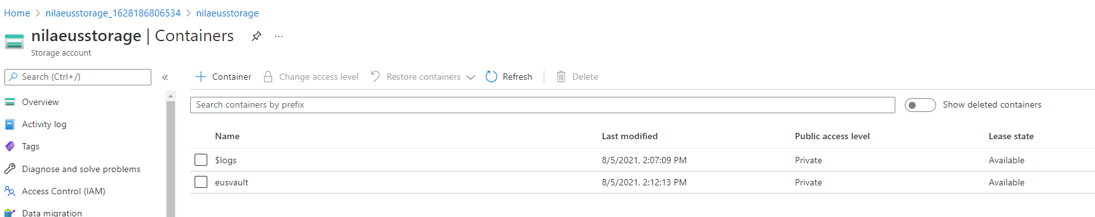
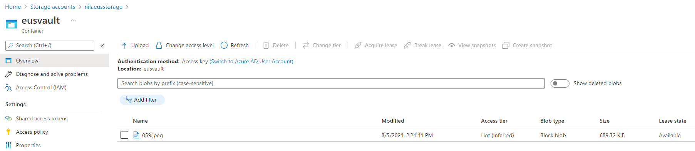
Create Container: eusvault
Upload image to container

Slide 34
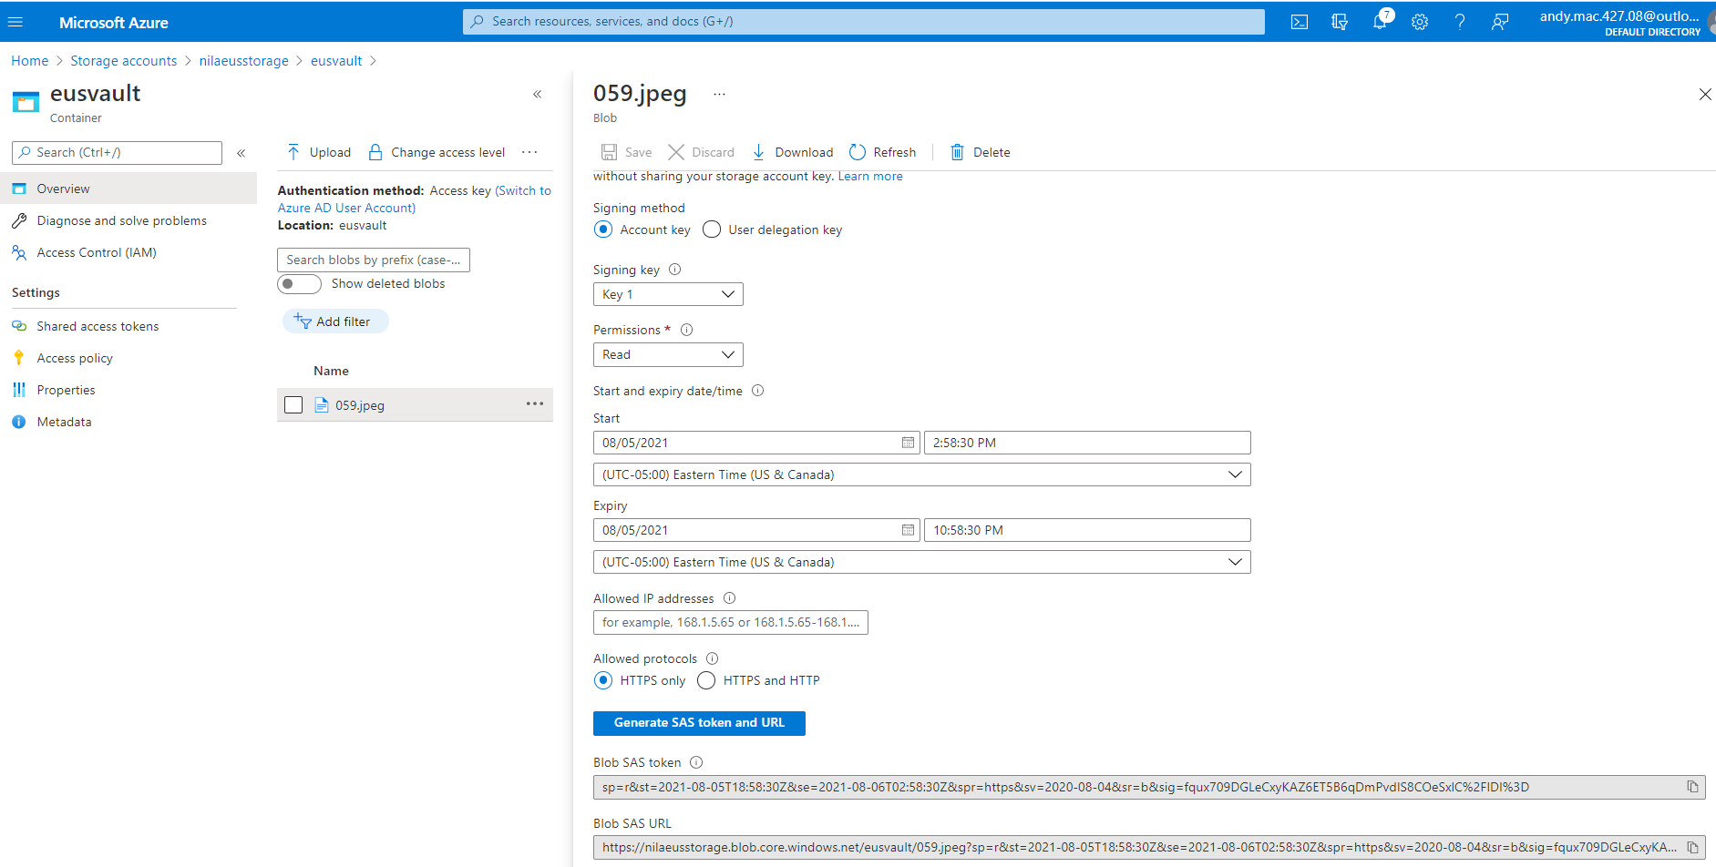
Generate SAS Token and URL and access from webserver

Slide 35
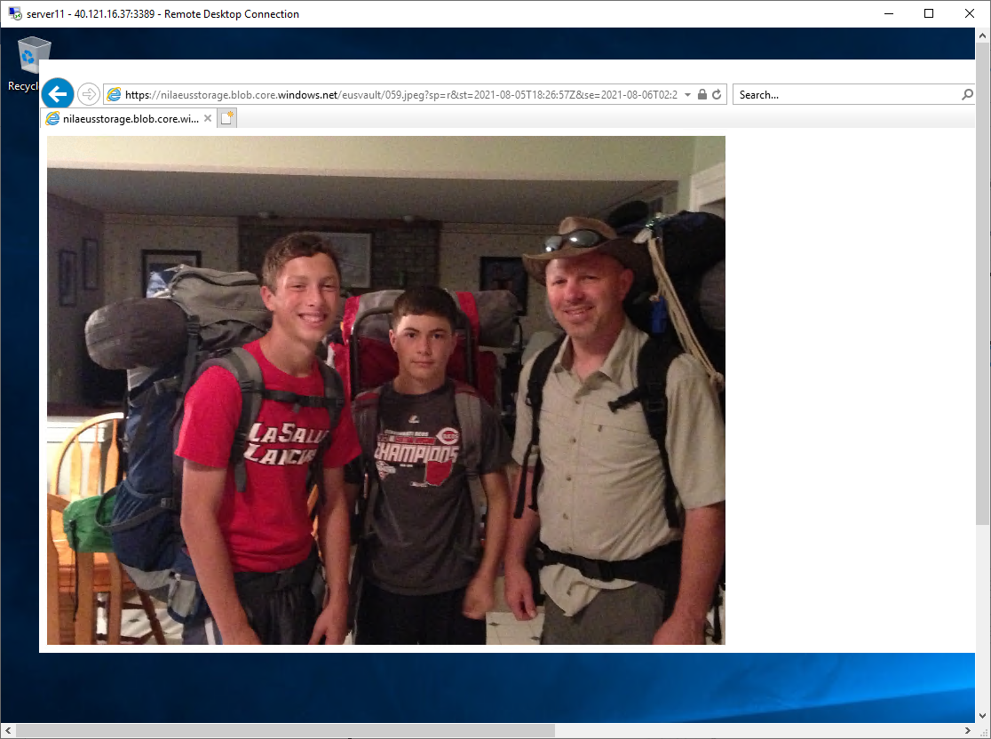
Access object from server11 webserver

Slide 36
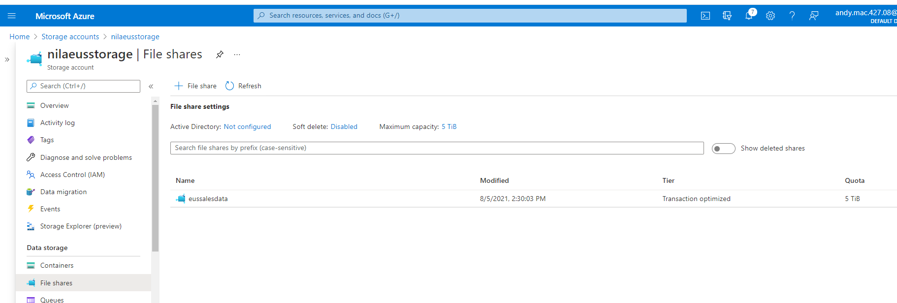
Configure File Share on storage account: eussalesdata

Slide 37
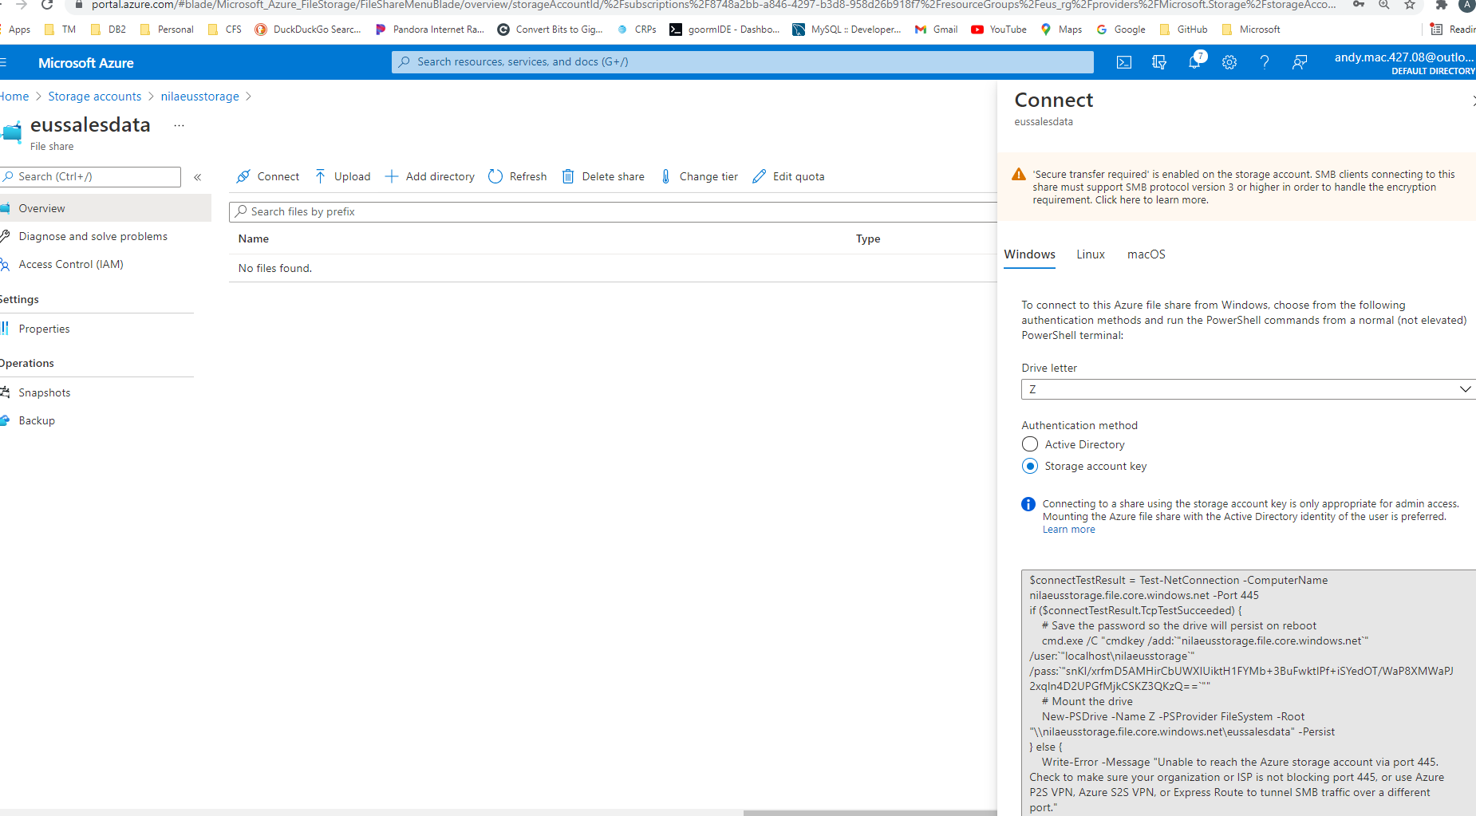
Generate storage account key for access

Slide 38
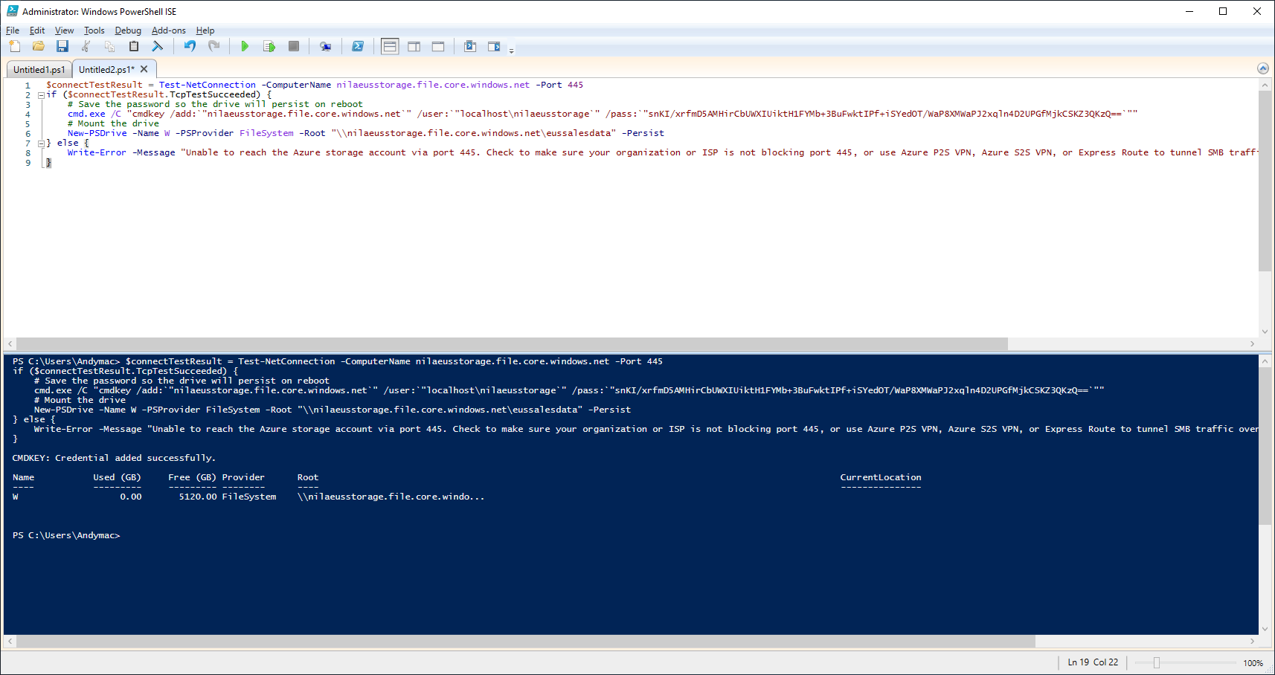
Create drive connection on webserver server11

Slide 39
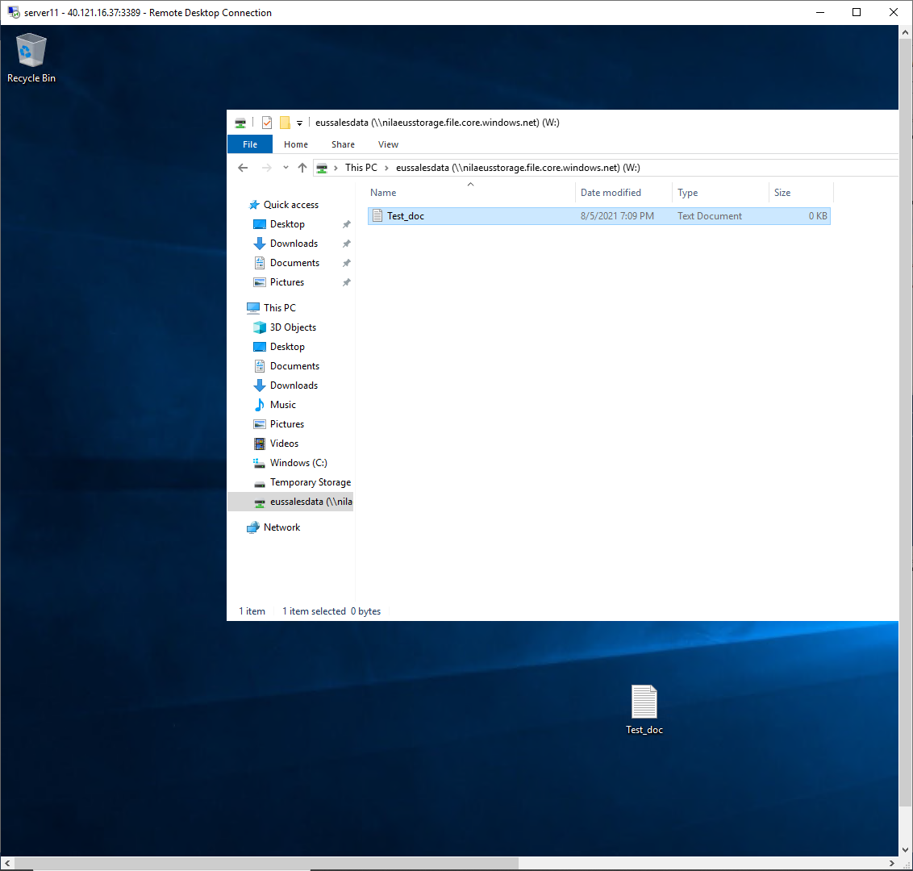
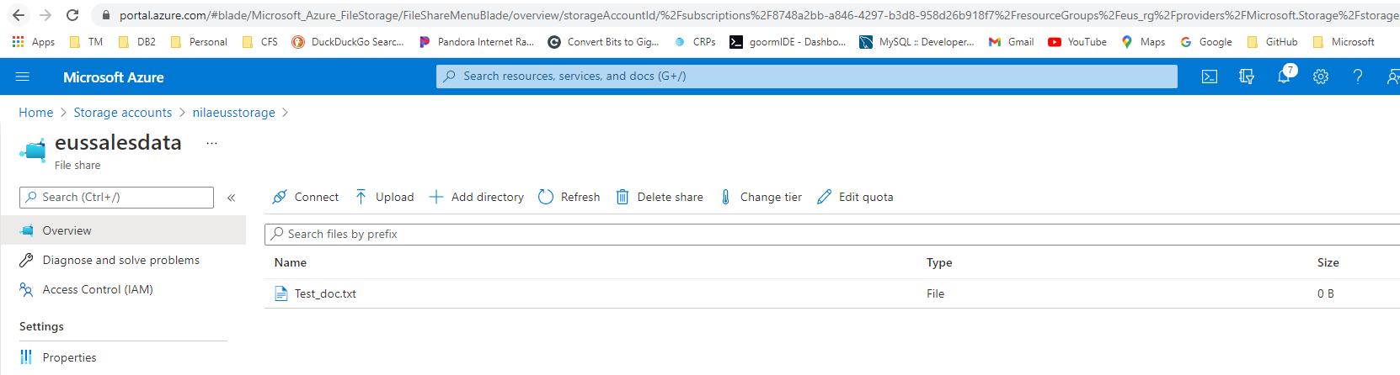
Store file from webserver into file share on server11

Slide 40
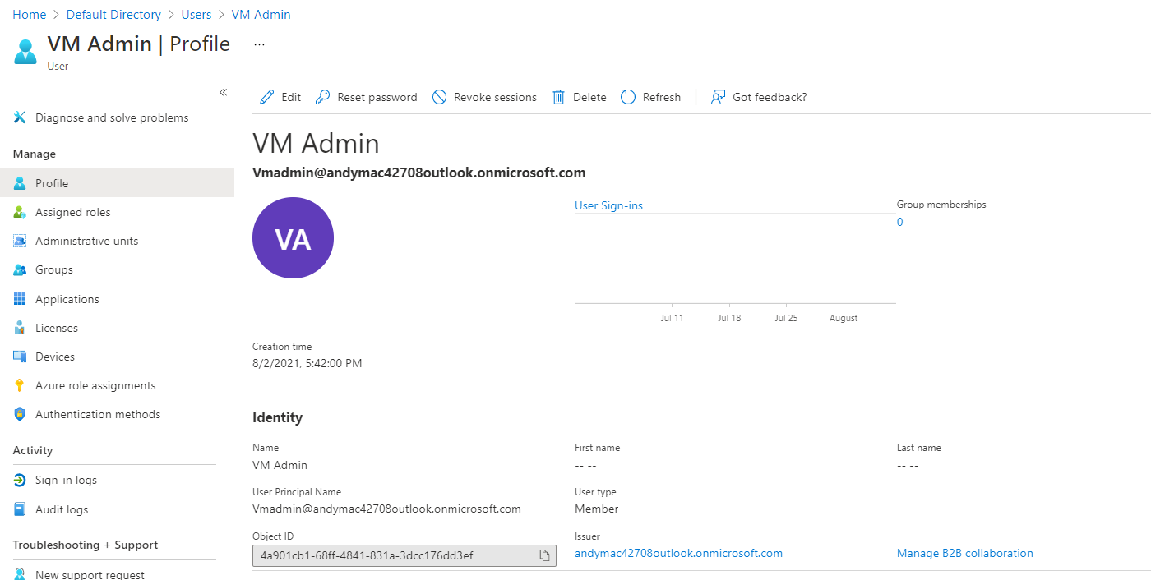
Create Vm_admin user

Slide 41

Assign VM_admin user to the ‘Virtual Machine Contributor’ for the entire subscription.

Slide 42

Create Backup_admin user

Slide 43

Assign Backup_admin user to the ‘Backup Contributor’ role for only the EUS_RG

Slide 44

CONNECTIVITY AND FUNCTIONALITY CHECKS:
RDP Connection to webserver1 from internet

Slide 45

RDP Connection to webserver2 from internet

Slide 46

RDP Connection to jumpserver from internet

Slide 47

RDP Connection to server11 from internet

Slide 48


Internet connection to seawebserver2 through loadbalancer
Internet connection to seawebserver1 through loadbalancer (stop seawebserver2 to force the connection)

Slide 49

Internet connection to eus server11

Slide 50

Connections from vm to the other to demonstrate interconnectivity via internal IP and vnet peering
Pings from seajumpserver to seawebserver1, seawebserver2, server11 via private ips

Slide 51

Pings from seawebserver1 to seawebserver2, server11, seajumpserver via private ips

Slide 52

Pings from seawebserver2 to server11, seajumpserver, seawebserver1 via private ips

Slide 53

Pings from server11 to seajumpserver, seawebserver1, seawebserver2 via private ips

